Slide 1
Maximizing Performance Using LXI
LAN eXtentions for Instrumentation
LXI Consortium Presentation
May 16, 2017
Notes:
Welcome to this series of presentations on LXI. This presentation is focused on achieving higher test system performance and development using LXI Devices.

Slide 2
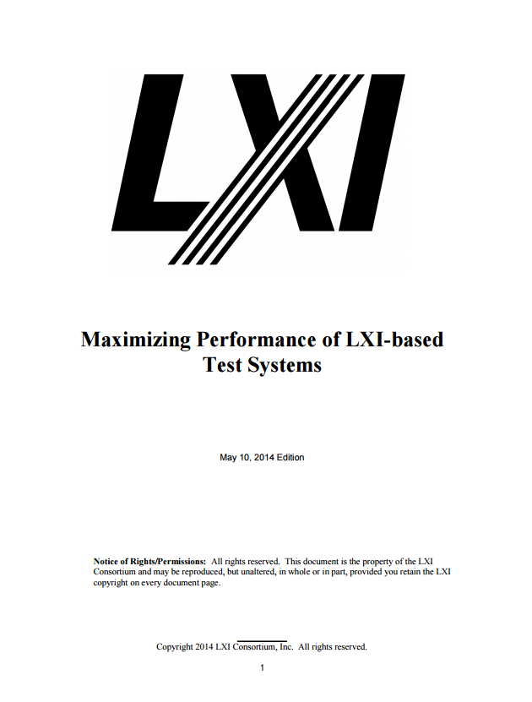
Maximizing Performance Using LXI
LAN eXtentions for Instrumentation
LXI Consortium Presentation
May 16, 2017
Notes:
Key points of this presentation were derived from the Maximizing Performance Using LXI document found on the LXI Consortium Web Site.

Slide 3
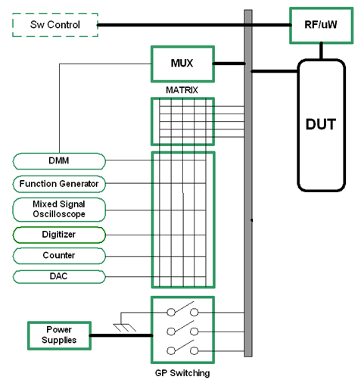
Key Assertions on Performance
I/O latency often has little impact in test
systems due to measurement physics
Distributed intelligence can greatly improve performance
…LXI has distributed intelligence
…LXI has additional benefits
Notes:
Here are two key performance factors in a typical test system.
I/O Latency has often been singled out as a huge performance factor. However, measurement physics often dwarfs I/O latency.
Distributed Intelligence simply means the device can accept some command or query, and the device performs all of the operations itself. This allows the computer to perform other operations in parallel.
LXI has inherent Distributed Intelligence, and there are other LXI benefits to better system development and performance
A third key factor not shown is poor understanding of programming devices….using unnecessary resets, wait statements, etc. We will focus on the first two.

Slide 4
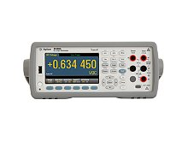
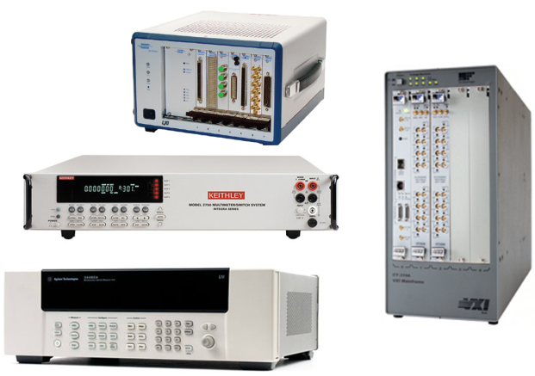
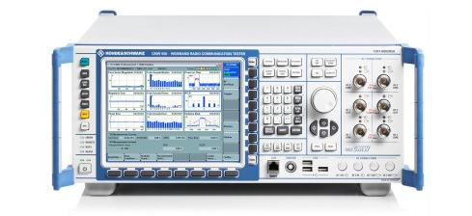
Test System Architecture
Interface
Notes:
A typical test system configuration provides matrix, general purpose, multiplexing, and even RF and microwave switching to connect between the instruments and the Device-Under-Test (DUT). Such a system may use instruments mounted in a rack, each with their own communication interface, display, and power supply. The system may also be composed of VXI, PXI, AXIe, or proprietary mainframes, with instruments and switches residing on modules plugged into one or more mainframe slots and a single communication interface to the computer.

Slide 5
Smart and Simple Devices
Distributed Intelligence
Command
Interface
Results
…computer sends commands…comes back later
Notes:
A typical test system may contain “Smart” devices, to Distribute Intelligence, which can perform operations on their own with little interaction from the controlling computer. These could be instrument modules in VXI, PXI, AXIe, or proprietary mainframes, stand-alone instruments, or a controller in a mainframe that accepts commands for all other modules in the mainframe

Slide 6
Smart and Simple Devices
Computer Controlled Fast I/O
Interface
Very fast I/O
…computer controls every register operation
…is typically involved until action is complete
Notes:
When the computer controls every register read and write of a module over a high-speed interface, it makes a module appear “Simple”. “Simple” means the computer must configure the module completely.
Some modules have more intelligence and can perform some levels of overlap, but, in general, the computer must finish all operations before moving onto the next module.

Slide 7
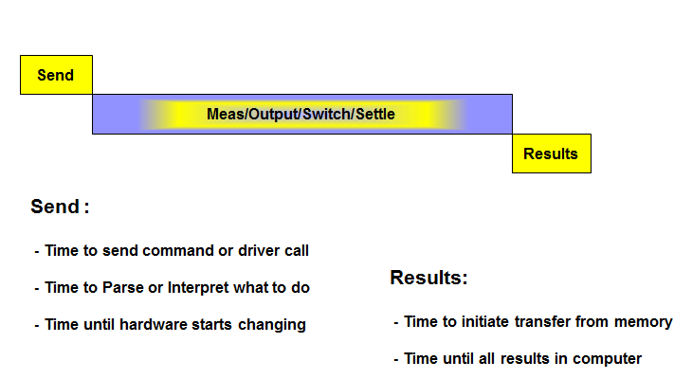
Key Performance Factors
Transaction Model
Notes:
A test program consists of sequences of configuring instruments, performing measurements, and returning measurement results. A test system usually consists of many instruments and/or modules to perform these operations.
The Transaction Model usually leads to serialized operations in most test systems - due to the driver call, programming method, or by choice of the programmer. The driver call usually performs all three operations before returning, so the overall operation completes before moving onto the next step in the sequence

Slide 8
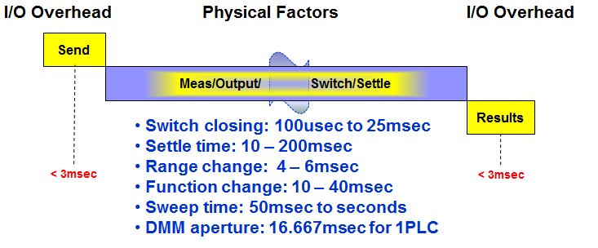
Key Performance Factors
Measurement Physics
Notes:
In most test systems, the Measure/Output/Switch/Settle dominates over the Send and Results. Input and output signal settling, mechanical switching times, Range changes, Function changes, Measurement apertures, Sweep times, etc. vary widely from microseconds to seconds. This is due to signal frequencies, the presence of noise, power supply settling times, etc.

Slide 9
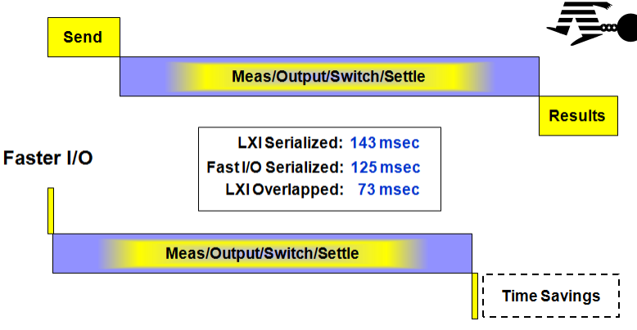
Key Performance Factors
Using Faster I/O
Notes:
If you only add a faster communications interface between the computer and the devices, you do save time, but that faster I/O can still be dwarfed by the measurement physics

Slide 10
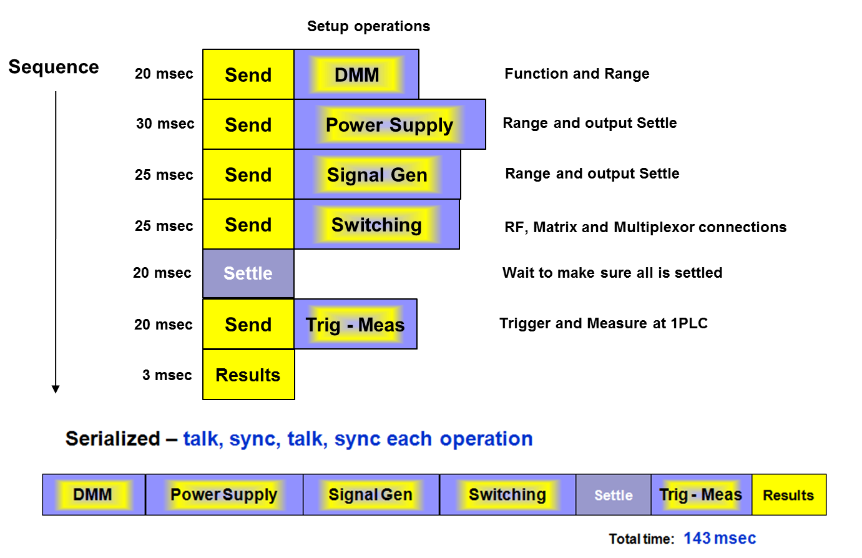
Enhancing Performance Case Study
Typical Performance
Routines written to wait for operation complete
Notes:
A sub-test sequence involves a DMM, Power Supply, Signal Generator, some switching, and a DMM. The figure illustrates the sequence of programming. Note the I/O time is included in each operation.
The bottom figure illustrates how all of the operations are performed typically in series….leading to a total time of 143ms in the example.

Slide 11
Enhancing Performance Case Study
Using Distributed Intelligence
Notes:
LXI Devices inherently have distributed intelligence, so a little planning and understanding of synchronization can yield tremendous time savings.
In this case, we program the DMM, Power Supply, Signal Generator, and Switching…but we don’t wait around for each to finish. This is called overlap processing and is possible with LXI Devices.
Through a little experimentation, one can determine which instrument has the longest time to finish the operation and settle and you then synchronize to that instrument. You need not worry about the others, since you know they will all be done before the Power Supply. In essence, you have removed the wait time of the DMM setup, Signal Generator, and Switching. You might give some additional settling time, but then you trigger the device and wait for the results…saving 70msec.

Slide 12
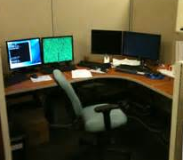
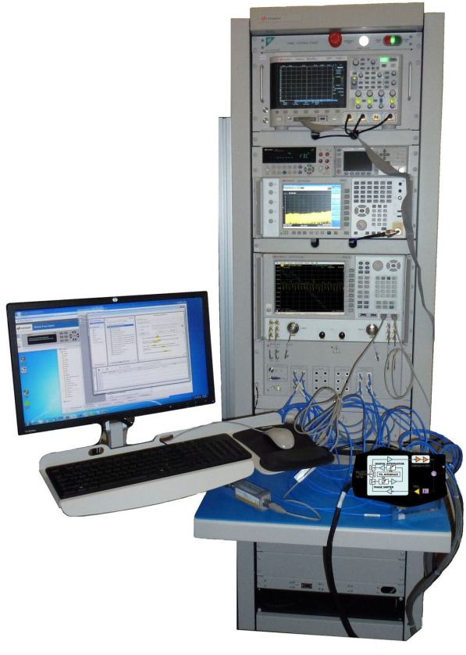
LXI Benefits
Expanding Test System Access
You want to work here…
14000 km
60 meters
…but your Test Systems are way over there
Notes:
For a test system engineer, it is usually inconvenient and uncomfortable to work next to the test system. You want the comfort of a quiet office environment to develop your test programs, and you may be supporting a test system not even in your facility.
This is a case of reducing your development test time, where you have the convenience of monitoring how LXI Devices are operating while your program is running. Using a debug tool to stop program operation and look at the system configuration is very beneficial.
LXI Devices mostly provide these monitor and control Web pages.

Slide 13
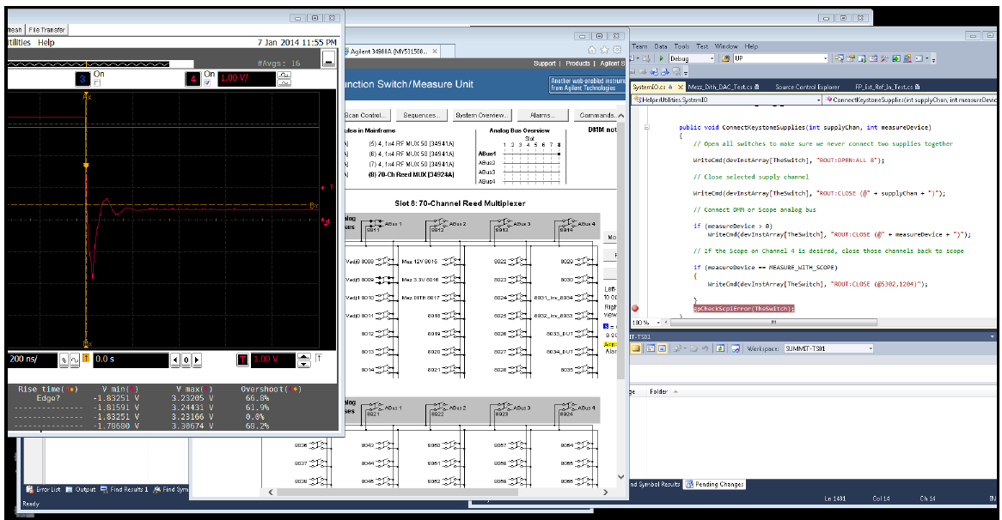
Fast development/troubleshooting with LXI
You can Remote Login to the Test System PC
You can monitor/debug your code via Web Pages
Test
Program
Web Page
Scope
Web Page
Switching
Notes:
With a Test System full of various signal generation, measurement, and switching products, you need a way to see what is going on…
It is a common solution to Remote Login to your test system…nothing special about that. But, with LXI Devices, that remote connection then provides Web Page access to the various measurement and control devices. For example, a test is failing, so you step through the test program looking at the result on the Scope Web page. Hmmm…not right…so, you check the switch path using the Switch Web Page. Ah…wrong combination of switches…problem solved! And, you did it from the comfort of your desk.

Slide 14
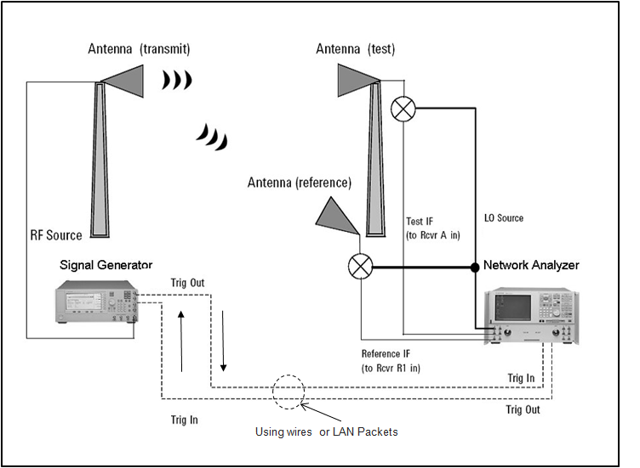
LXI Benefits
With LAN you are not limited by cables
Notes:
Some LXI Devices provide LAN Triggering and Messaging, such that a long distance can exist between two devices. This is an example of antenna testing, where the two LXI Devices are located line-of-sight apart. LAN packets travel over the company-supplied LAN VPN to sequence the operations.

Slide 15
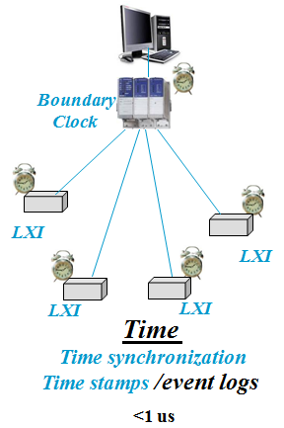
LXI Benefits
Time synchronization another way to trigger
Notes:
Some LXI Devices also provide precision clock synchronization, whereby each device on the LAN maintains its local clock accuracy to a system Boundary Clock. No wiring needed in these cases, as everything is oriented around the time of day.

Slide 16
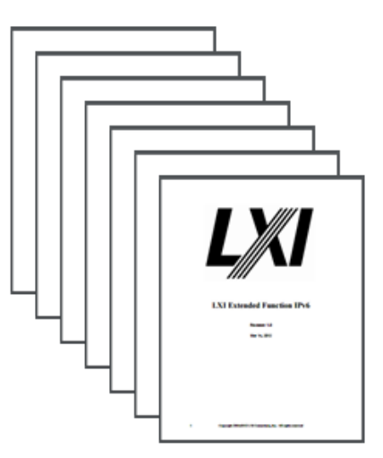
Next Steps – Guides/Videos for Using LXI
LXI Getting Started
Building LXI-Based Test Systems
Introducing LXI To Your Network Administrator
Maximizing Performance of LXI-Based Test System
Test Systems Using LXI
LXI Networking Basics
http://www.lxistandard.org/About/Guides-for-using-LXI.aspx
Notes:
LXI Devices can certainly provide a variety of options in achieving faster test system development and performance. Please refer to these documents for more detail.
Thank you for your time.

